Slide 2
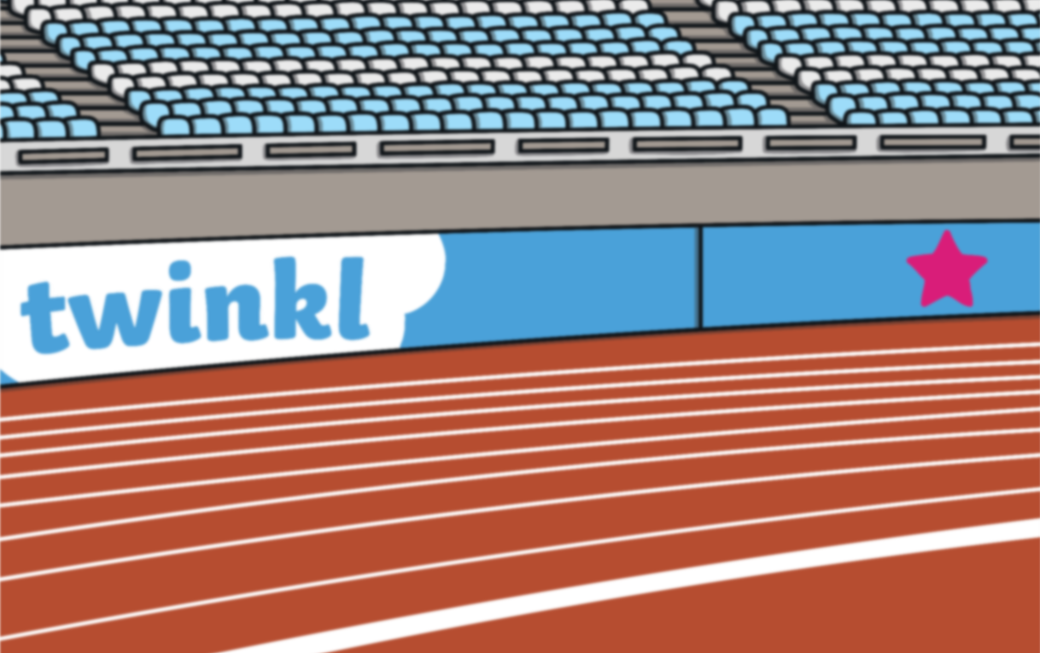
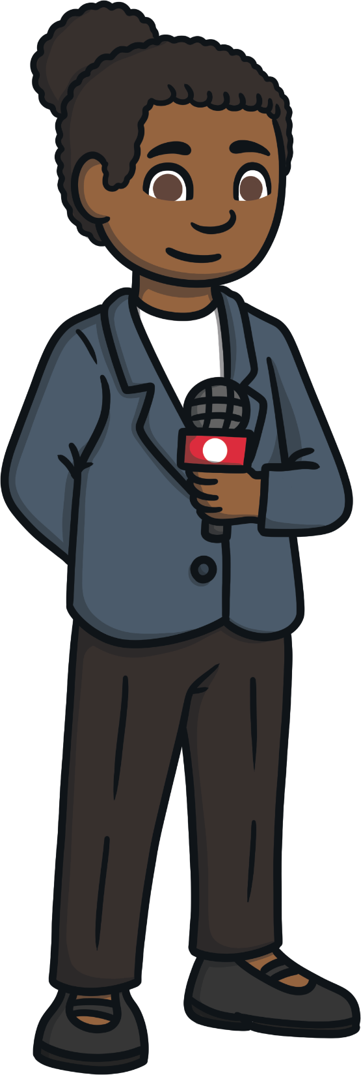
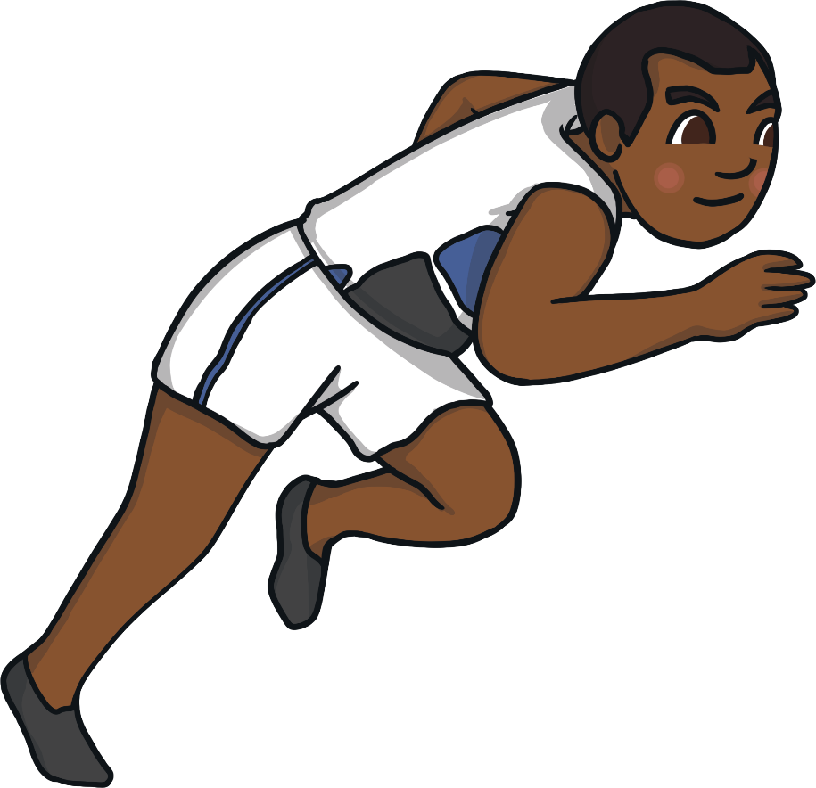
What Are the Summer Games?
A famous American athlete, Jesse Owens, won four track and field events at a single Summer Games. He was the first athlete to do so.
The Summer Games are an international competition where athletes from around the world compete in different sporting events.
Do you know the names of any famous athletes and the sports that they have competed in?
The Summer Games are one of the most important sporting events for athletes, giving many the chance to showcase their talents to the world.

Slide 3




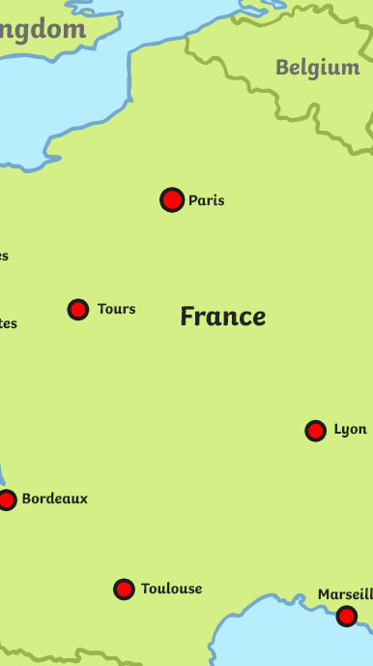
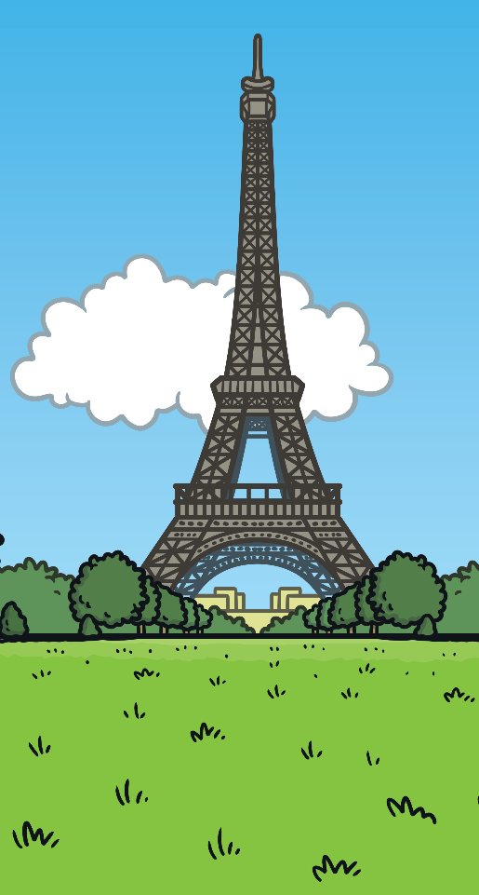
When Are the Summer Games?
The 2024 Summer Games will be held
in Paris, France,
from the 26th July to 11th August 2024.
France are hosting
the Summer Games
for the third time. They hosted them previously in 1900
and 1924.
Over 10,500 athletes from around the world will take part.

Slide 4

How Did the Summer Games Begin?
The first record of the Games is from 2,800 years ago in 776 BC. They were part of a religious festival celebrating the Greek god, Zeus.
The Games took place in Olympia and included events such as wrestling, boxing, javelin, long jump, discuss and chariot racing.
Strict rules at the Games meant only men and boys were allowed to take part.
The Games continued to be held for over 1000 years. However, it is thought that the quality of the Games started to decline and by AD 393, an emperor named Theodosius I called for the ancient Olympic Games to be cancelled.

Slide 5
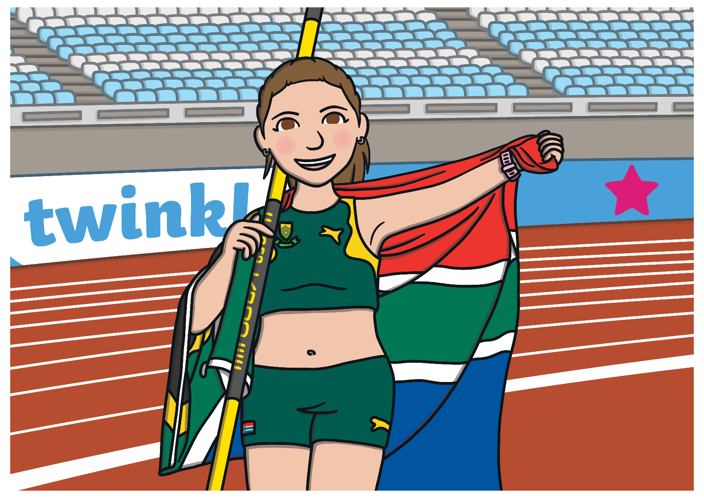
The Modern Summer Games
Around 1500 years after the ancient Olympic Games were cancelled, a French baron named Pierre de Coubertin wanted to promote physical education.
Throughout its history, the Summer Games have only been cancelled or postponed four times.
The first modern Summer Games were held in 1896 in Athens, Greece. 14 different countries competed.
The First World War stopped the Games in 1916, it was cancelled in 1940 and 1944 because of the Second World War and in 2020 it was postponed as a result of the coronavirus pandemic.
After visiting the ancient Greek site of Olympia, he was determined to bring back the Games.
Since then, the modern Summer Games have been held every four years in many countries around the world.
He suggested that every four years an international athletics competition should take place.
Two years after his proposal, the International Olympic Committee started.
postpone: To arrange for something to take place at a later time than first scheduled.

Slide 6

Summer Games Hosts
This timeline shows the cities around the world that have hosted the Summer Games since the first competition in 1896.
1904
St Louis, USA
1912
Stockholm, Sweden
1920
Antwerp, Belgium
1928
Amsterdam, Netherlands
1936
Berlin, Germany
1952
Helsinki, Finland
1968
Mexico City,
Mexico
1976
Montreal, Canada
1984
Los Angeles, USA
1992
Barcelona, Spain
2000
Sydney, Australia
2016
Rio de Janeiro,
Brazil
2024
Paris,
France
1896
Athens, Greece
1944
Cancelled
WWII
1960
Rome, Italy
2008
Beijing,
China
1900
Paris, France
1908
London, England
1916
Cancelled
WWI
1924
Paris, France
1932
Los Angeles, USA
1940 Cancelled
WWII
1948
London,
England
1956
Melbourne, Australia
1964
Tokyo, Japan
1972
Munich, Germany
1980
Moscow, Russia
1988
Seoul, South Korea
1996
Atlanta, United States
2004 Athens,
Greece
2012
London,
United Kingdom
2021
Tokyo,
Japan
2028
Los Angeles,
USA

Slide 7

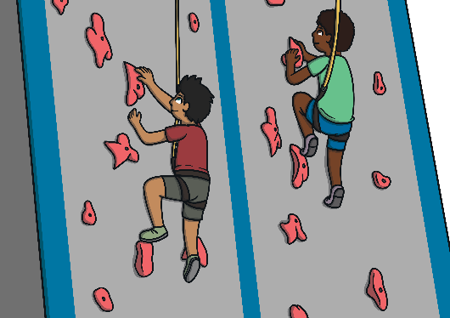
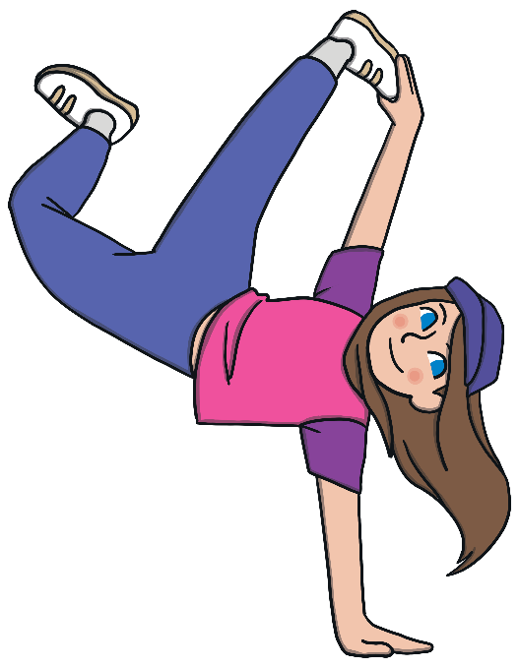
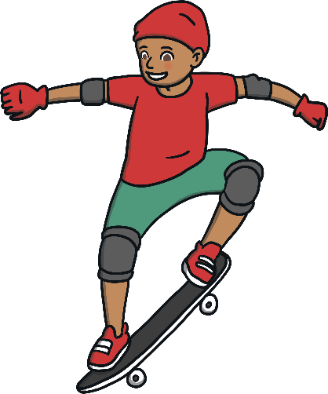
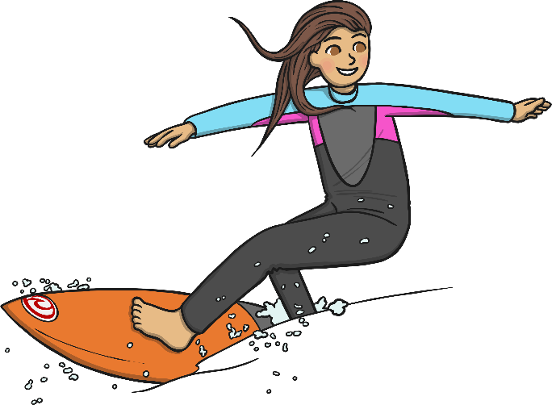
What Sports are at the Summer Games?
41 sports plus 4 additional sports will feature at the 2024 Summer Games in Paris. Several of these sports are considered ‘core’ sports and these have featured at Summer Games in the past. The 4 additional sports that have been chosen for these Summer Games in Paris are Breaking, Sport Climbing, Skateboarding and Surfing.
x
x
Breaking
A style of dance that originated in the United States in the 1970s. Breaking was selected as one of the four new sports to compete at the Paris Summer Games following its success
at the 2018 Youth Summer Games.
How will it work?
There will be men’s and a women’s events where athletes compete against each other in solo dance battles.
x
x
Sport Climbing
Climbers compete in three formats: boulder,
speed and lead.
How will it work?
Lead - athletes climb as high as possible on a wall over 15m in height.
Boulder - athletes climb a wall roughly 4.5m in height and without ropes.
Speed - athletes race against the clock to scale a 15m high and inclined wall.
Surfing
Athletes use special boards, called shortboards, that allow them to perform tricks on a wave. The boards are faster and allow more manoeuvrability than regular surfboards.
How will it work?
Surfers are judged on their speed, power
and flow during their surfing set.
Skateboarding
Skateboarders compete in two disciplines: park and street
How will it work?
Park takes place on a bowl shaped arena with
ramps and hills. Athletes are judged on the height,
complexity and speed of their tricks.
Street takes place on a course that more closely
resembles a street. There are steps, rails and ramps.
Skaters are judged on their tricks and control
during two 45-second runs.
Archery
Artistic Gymnastics
Artistic Swimming
Athletics
Badminton
Basketball
Basketball 3 x 3
Beach Volleyball
BMX Freestyle
BMX Racing
Boxing
Breaking
Canoe Slalom
Canoe Sprint
Diving
Equestrian
Fencing
Football
Golf
Handball
Hockey
Judo
Marathon Swimming
Modern Pentathlon
Mountain Biking
Rhythmic Gymnastics
Road Cycling
Rowing
Rugby
Sailing
Shooting
Skateboarding
Sport Climbing
Surfing
Swimming
Table Tennis
Taekwondo
Tennis
Track Cycling
Trampoline
Triathlon
Volleyball
Water Polo
Weightlifting
Wrestling

Slide 8
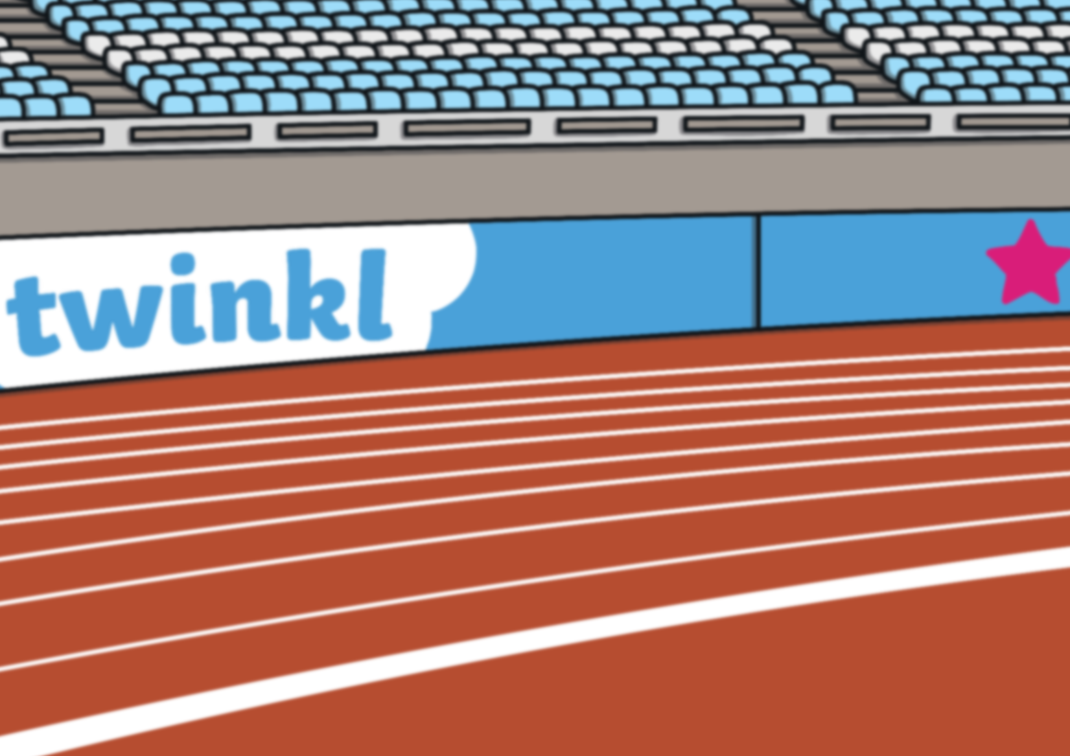
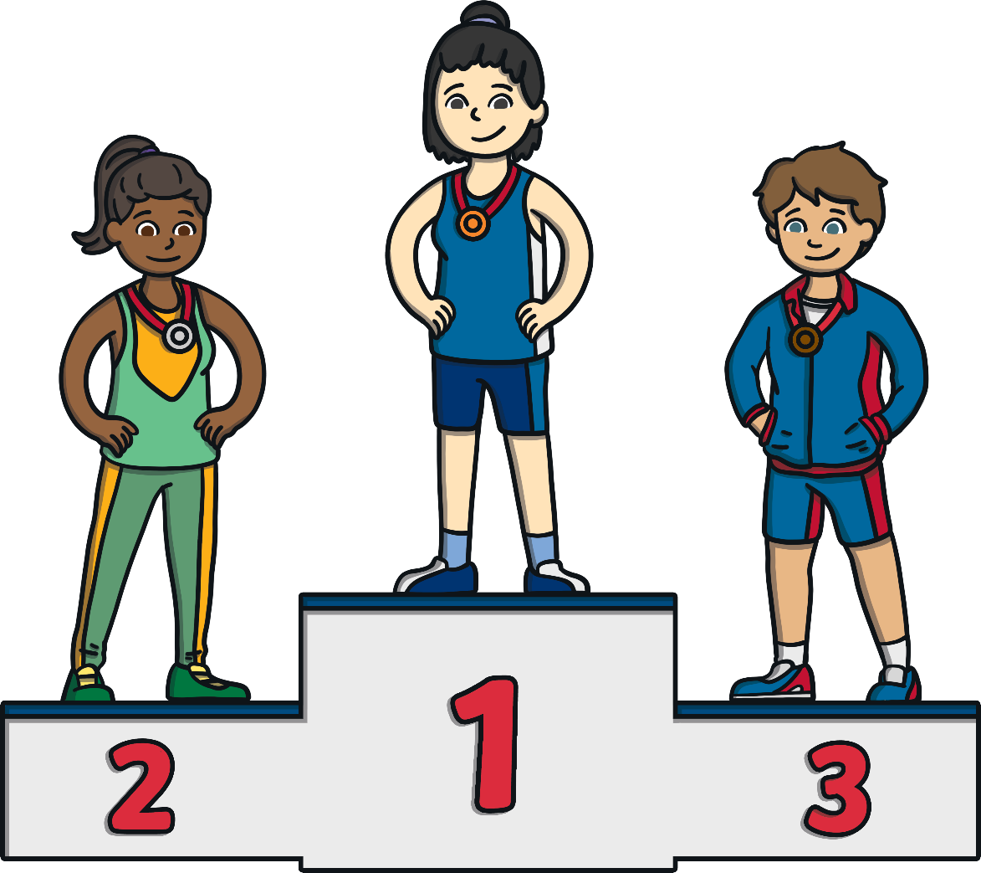
Medal Ceremony
At the end of each event, a medal ceremony is held where the winner, the second and the third-place athletes or teams are awarded their medals.
The national flags of the medalists are raised and the national anthem from the gold medalist’s country is played.

Slide 9
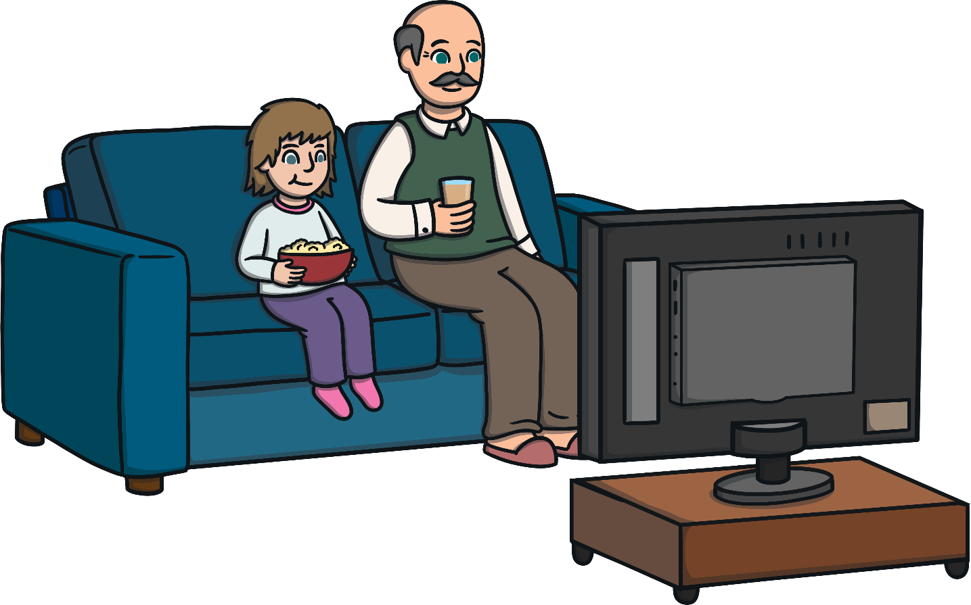
Will You Be Watching?
On 26th July 2024, the XXXIII edition of the Summer Games begins,
with over 10,500 athletes from all over the world.
Who are you most interested in seeing compete?
Which sports and events do you think you might watch?
Are there any that you’ve never seen before?

Slide 10
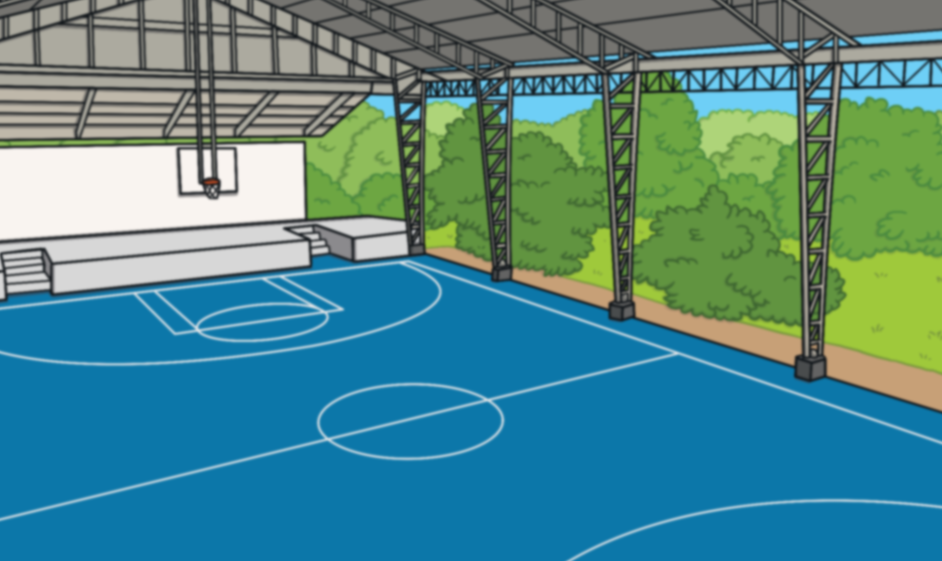


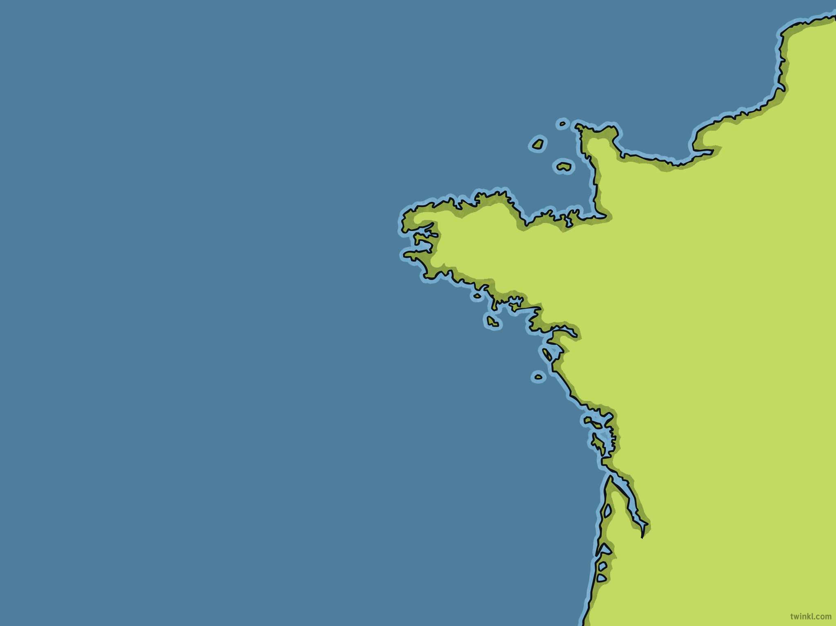
Quick Quiz
In what city is the 2024 Summer Games being held?
Including the 2024 Games, how many times has France hosted the event?
Who famously founded
the International Olympic Committee?
Pierre de Coubertin
Paris
three
What additional sports are featuring at the 2024 Games?
breaking, surfing, skateboarding and sport climbing

